Slide 1
LiDAR
Getting Started with Point Cloud Data in UE4

Slide 2
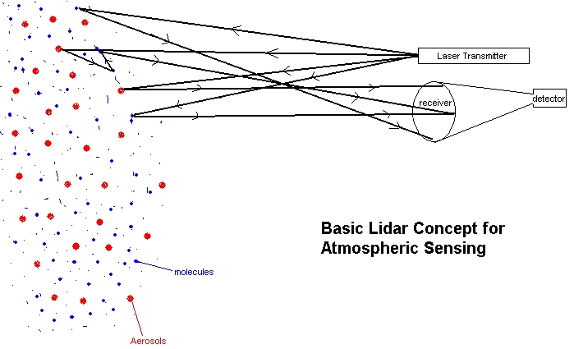
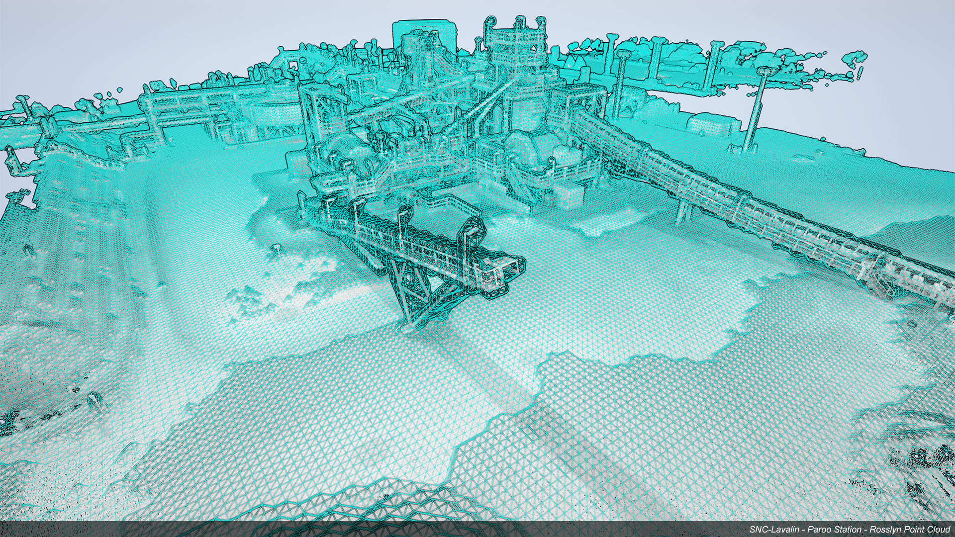
What is LiDAR
Light Detection and Ranging
Similar to Radar
Uses light detection to create 3D points.
A collection of these points are known as a “point cloud”
ece.arizona.edu

Slide 3
What is a point cloud
Point clouds are large data sets composed of 3D point data. Aerial LiDAR (Light Detection And Ranging) laser scanners are the most common instruments used to collect geographic point cloud data. Geographic LiDAR data is most commonly available in LAS (LiDAR Aerial Survey) or ASCII (. xyz) format.
https://knowledge.autodesk.com/

Slide 4
How to create them quickly for use in UE4

Slide 5
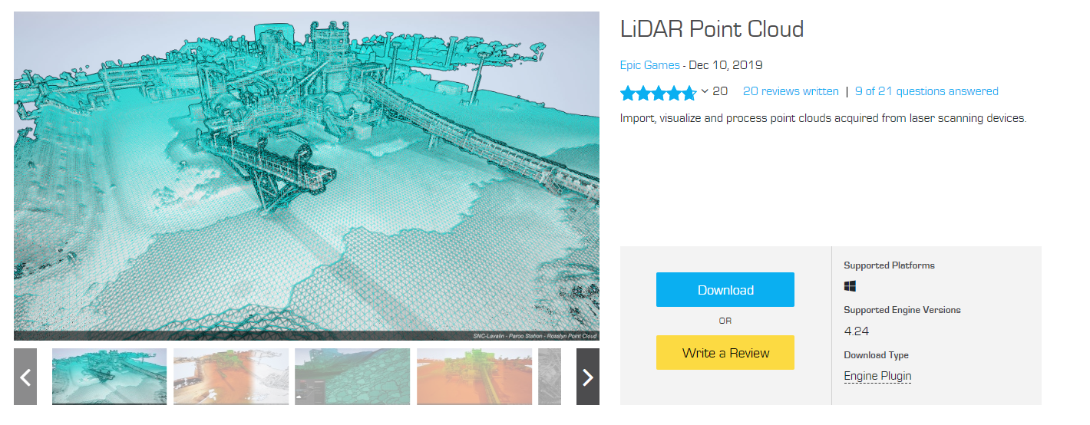
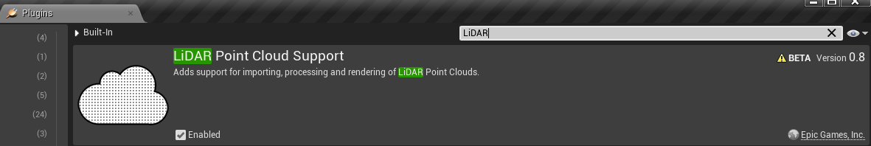
Epic Games has provided a Free plugin for the Unreal Engine that allows their users to import and manipulate LiDAR Point Cloud data into their engine. Once downloaded, you will want to go into the Plugins window of your project and enable the plugin. This will require a restart of the project.

Slide 6
Required Equipment / Software
Video Camera (cell phone will do)
Video editing software (we’ll need to export the video into an image sequence. While you can do this in UE4, I recommend a program like Premiere or After Effects)
Agisoft Metashape (link)
And of course….
Unreal Engine 4

Slide 7
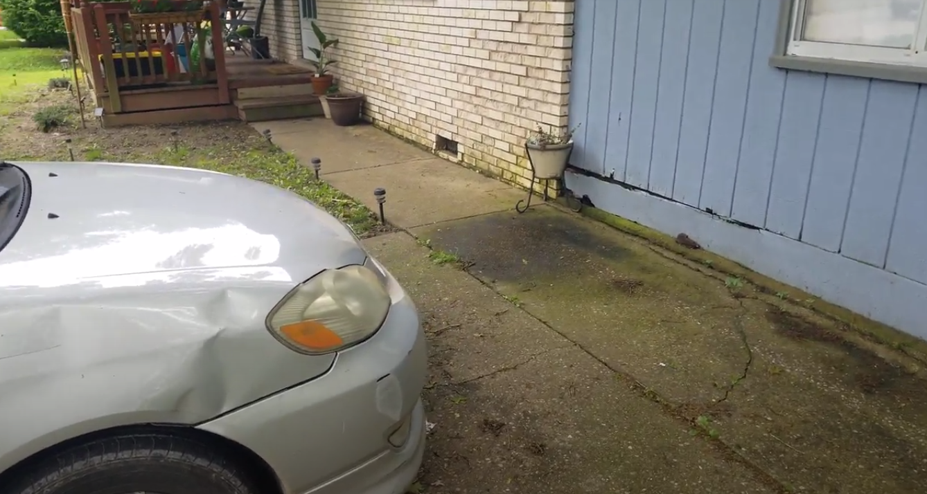
Collect Sample Video
The higher the resolution the better
Recommended 4k
Record while slowly around targets and capturing all the angles

Slide 8
In this example we’ll be using
Adobe After Effects
to prep our video

Slide 9
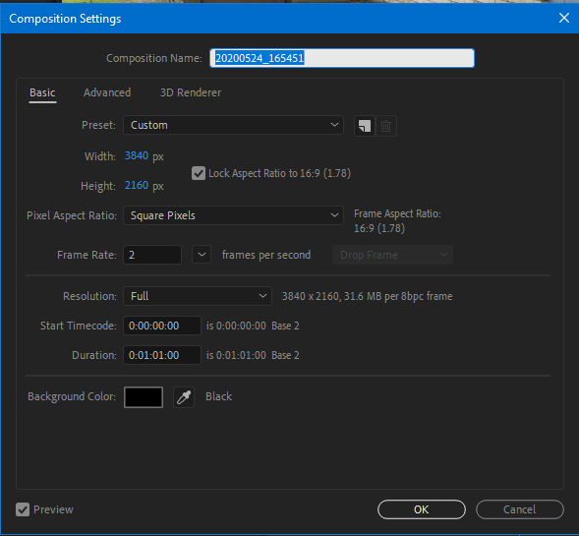
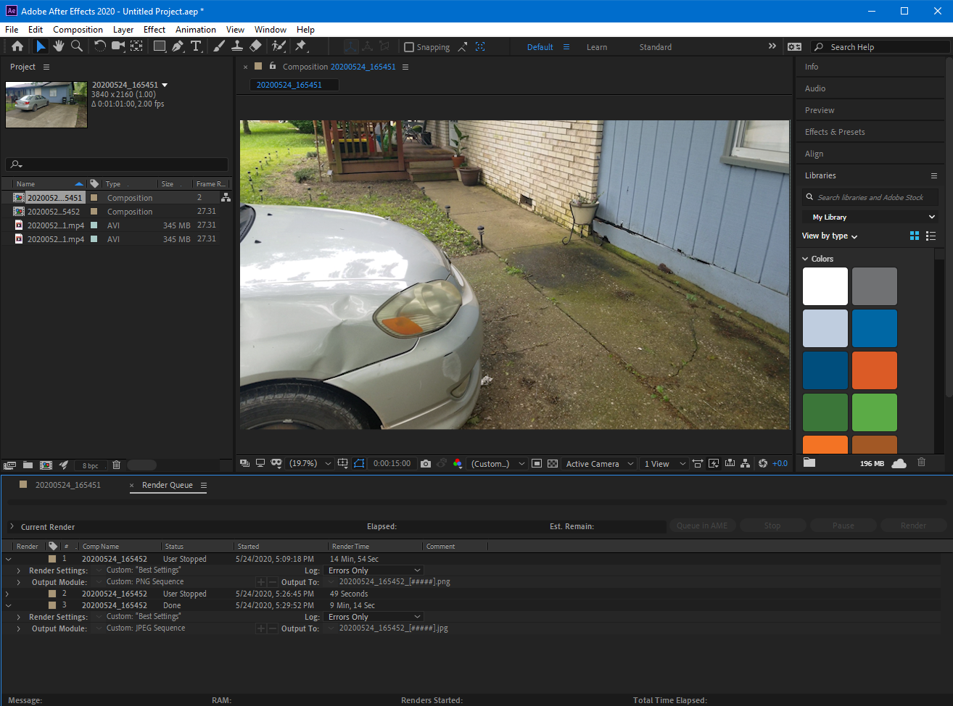
First change the desired frame rate down to about “2”. This will significantly decrease the amount of time it takes to generate the point cloud and will provide enough smooth data to get a result we are happy with.

Slide 10
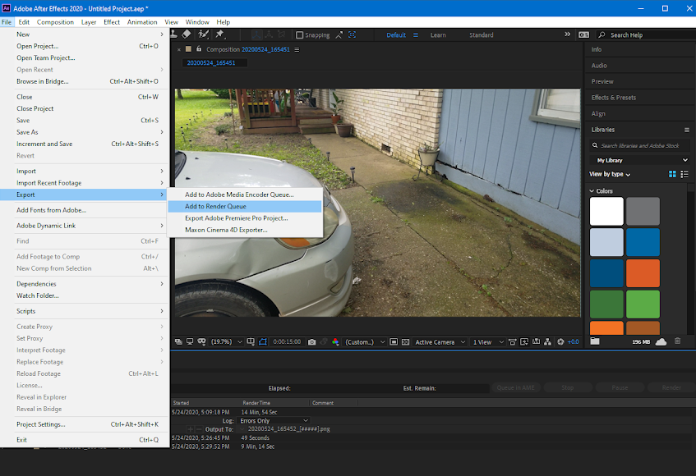
Next, under the “File” tab in the toolbar, select Expot > Add to Render Queue.

Slide 11
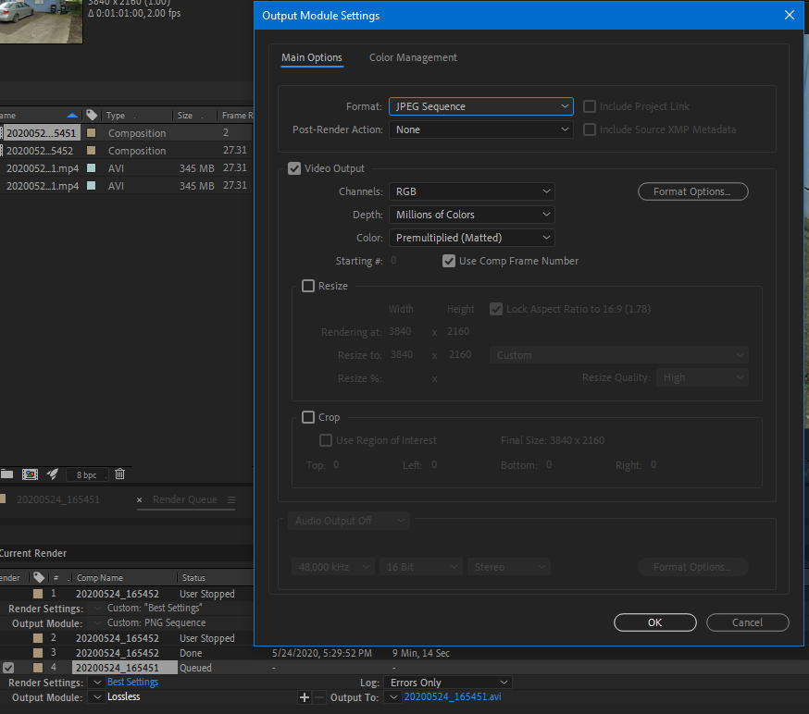
Next we’ll need to change the Output Module Settings to export into either a PNG sequence or a JPEG Sequence.

Slide 12
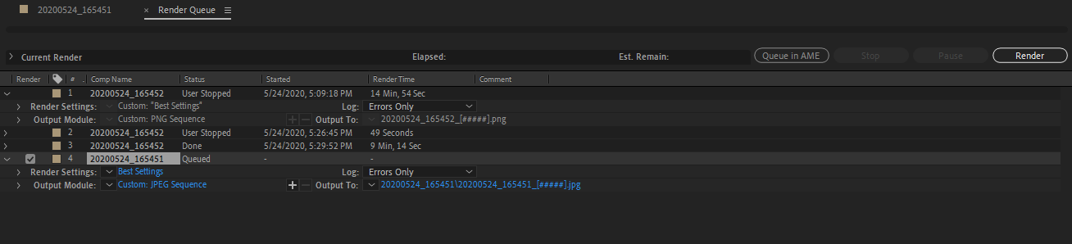
Render out the sequence.
This part may take a while depending on the size of the video.

Slide 13
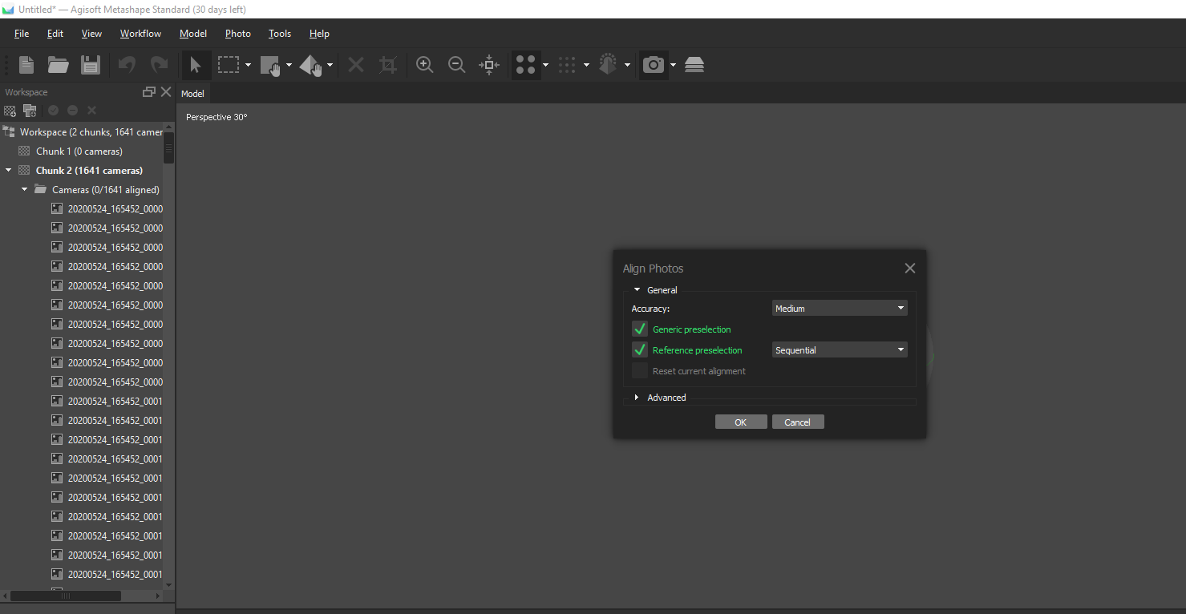
Once it’s finished, upload those photos into Agisoft, click on Workflow > Align Photos
The following window will pop up and you’ll probably want to set your settings to medium and Sequential if they aren’t already.

Slide 14
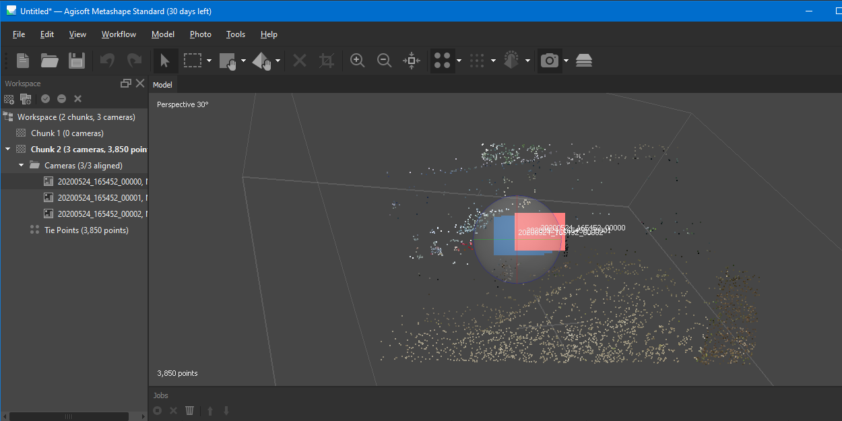
This will essentially turn each photo in reference to the last and create the depth and color of each point in the point cloud. For this example I chose only three photos to save on time. The higher the settings from the previous slide will create more points but also increase your render times.

Slide 15
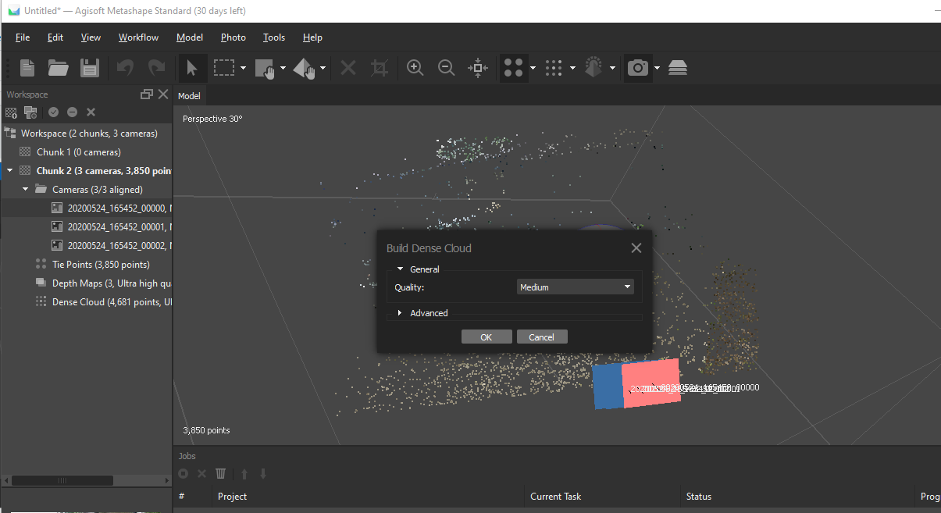
Next we want to select Workflow > Build Dense Cloud This will, well, make the point cloud more dense. It will also do a better job at getting a more accurate depth from the cameras.

Slide 16
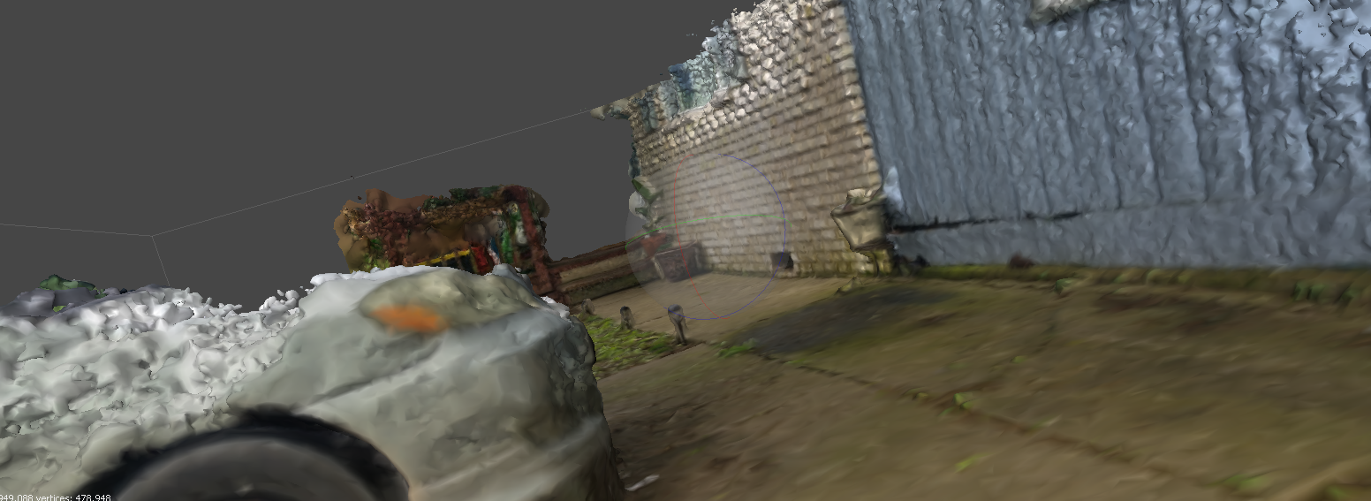
At this point you are able to export the point clouds for Unreal Engine.
File > Export..
Using the LiDAR plugin you are able import the point cloud data as either .las or .txt files Under Workflow, you can also generate a model from the point clouds.
This model will likely be noisey and high poly but could be cleaned up using other programs.
Photo
Generated Model

Slide 17
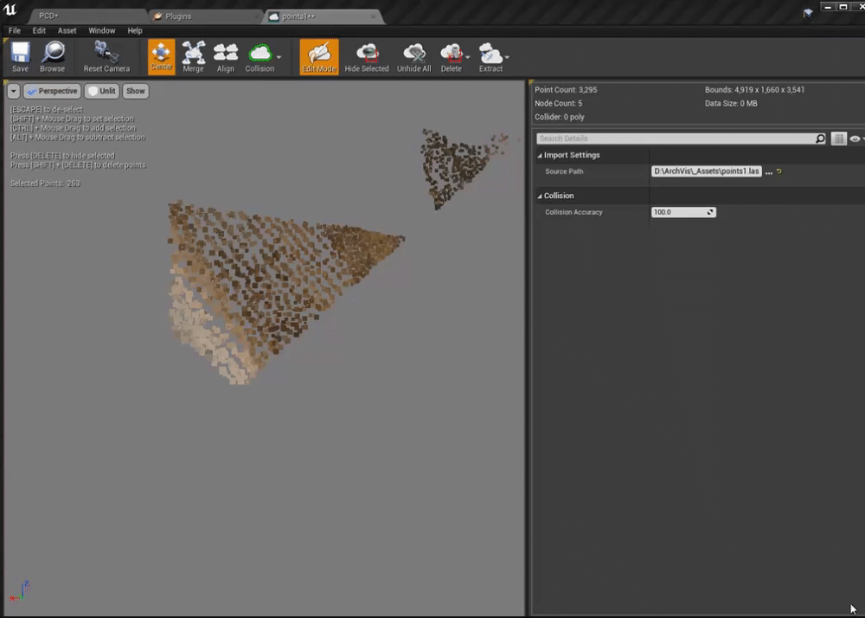
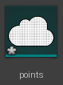
Once the point cloud data is inside of Unreal Engine you can add collision, remove points, merge with other point clouds and much more. We’ll be using point cloud data extensively while recording historical sites and construction projects for Remake West Virginia.
Thank you! Don’t forget to share what you make with us :)

